Slide 1
CogniSync
CMPS Capstone - Milestone 6
Justin Haysbert, Gabe Sagrera, Shayne Shelton, Ryan Stevens

Slide 2

Pitch
Brain Computer Interfaces will change the way we interact with technology
Advancements in healthcare, communication, gaming, more
Our application
EEG controlled wheelchair
Classification models that understand intent

Slide 3
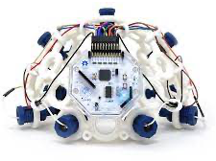
Pitch cont.
Current Application
Movements - Right, Left, Backwards, Forwards
Mapping - MI of right arm, left arm, jaw clench, and legs
Models can generalize to accommodate to user needs

Slide 4
Original Goals
Record a full session on our GUI
Recording
Modeling
Outputting controls(Predicting)
Implement Tensorflow or PyTorch rather than just scikit-learn machine learning techniques

Slide 5
What we have done
Recorded a full 60 minute recording session of 4 movement types
40 of each movement:
Randomly ordered
Left arm, right arm, jaw clench, and legs
~1 million observations, 11 features (8 channels, 3 alphas)
Implemented scikit-learn models
Support Vector Classifier, Linear Discriminant Analysis, Random Forest Classifier

Slide 6
What we have done
Implemented Tensorflow with CPU
Unable to get GPU to work on windows
Can try using a Linux OS instead
Implemented PyTorch with CPU and GPU
Built and began programming model robotic wheelchair

Slide 7
Demonstration

Slide 8
What's left to do
Finalize what GUI features we need/want at the SSE Expo
Machine Learning
Finalize PyTorch implementations in GUI
Possibly work with Ubuntu and Tensorflow
Connections to make
Machine learning models/predictions to snake game controls
Model wheelchair controls and GUI
Machine learning models/predictions to robotic wheelchair controls
Model and 3D print the robotic wheelchair a casing to look like a wheelchair

Slide 9
Plan for the rest of the semester
3/18 - 3/22:
Finalize GUI features
Implement PyTorch in GUI
3/25 - 3/29:
GUI connected to robotic wheelchair controls
Connect model predictions to snake game and/or robotic wheelchair controls
4/1 - 4/5:
Finalize all GUI connections
Sketch a wheelchair casing for demonstrations
User training and modeling optimization
4/8 - 4/12:
Finalize SSE Expo poster
Print wheelchair casing
4/15 - 4/19:
Finalize GUI for demo
4/23: SSE Expo
Notes:
Weekly plan and picture timeline

Slide 10
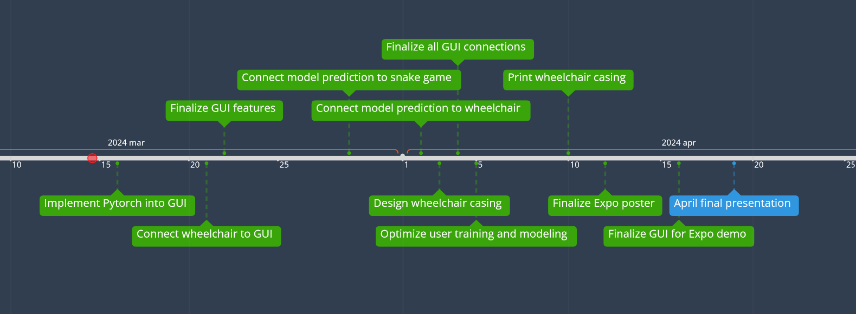
Timeline

